Slide 1
Sentiment Analysis
Human Language from a Computational Perspective
June 27, 2018

Slide 2
Outline
Text classification
Machine learning algorithms

Slide 3
Text classification
Many problems involve classification:
Topic [news, sports, ...]
Author/gender [male, female]
Spam filtering [spam, not-spam]

Slide 4
Sentiment classification
Given an input sentence, return its sentiment label:
+1 (positive) 0 (neutral) -1 (negative)
(or a number on a finer scale, e.g. 1-5)

Slide 5
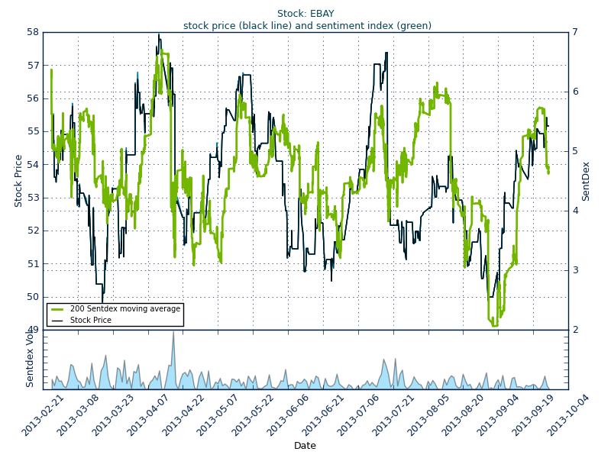
News and stocks
sentdex.com

Slide 6
Twitter
V_FSD: RT @FreeMemesKids: Love my new fidget spinner https://t.co/IcA6Ui6fsV
MeqzEdits: @23Duckk Oh no the fidget spinner?
fffaraa: @ibrahimyussop Omg.. not the fidget spinner
boybrunch: RT @a1andar: The Born This Way album cover except Gaga is a fidget spinner
eve_bertie: I bought a fidget spinner and I think it's the best thing I've ever done
Hamza0207: I broke this little girls fidget spinner and I legit feel so bad ??
sentiment140.com

Slide 7
Algorithm requirements
Input: sequence of tokens
[oh, no, the, fidget, spinner, ?]
Output: label (number)
-1

Slide 8
Bag of words
Simple approach: ignore the order, and just look for indicative tokens:
not great damn love hate ...
Assign a weight to each token:
0 +1 -1 +2 -2 ...

Slide 9
Bag of words: classification
Calculate score for sentence:
the only reason i love mondays ... zumba !!!!
0 + 0 + 0 + 0 + (+2) + (-1) + 0 + (+1) + (+1)
= +3
Since 3 > 0, predict:
+1 (positive)

Slide 10
Bag of words algorithm
classify(L, W): ▷ L: input sentence,
s ← 0 W: table of weights for words
i ← 1
while i ≤ len(L):
s ← s + W[L[i]]
i ← i + 1
return sign(s)
+1 if s > 0
0 if s = 0
-1 if s < 0

Slide 11
Learning a model
How to determine the word weights?
In language models and POS tagging, we learned the statistics as Counts.
Here we can learn Weights.

Slide 12
Perceptron
The perceptron is a learning algorithm.
Input: list of samples (sentence + label)
Labels given as numbers: +1 0 -1
Output: table of weights for each word
(which can then be used to classify new sentences.)

Slide 13
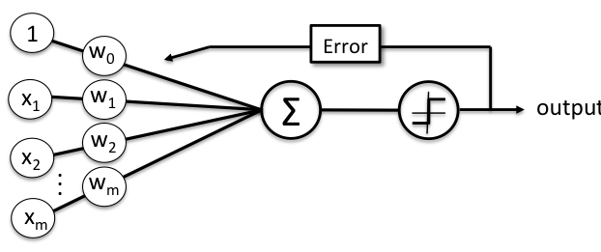
Perceptron
The algorithm goes over all samples repeatedly, until there are no errors.
Whenever there is an error, it updates the weights of all tokens in the sample.

Slide 14
Perceptron algorithm
train(X, Y): ▷ X: list of input sentence (samples)
W ← [0 for all words] Y: list of labels (one per sample)
while W is changing: ▷ training iterations
i ← 1
while i ≤ len(X): ▷ go through all samples
if classify(X[i], W) ≠ Y[i]: ▷ if the model is wrong,
update(X[i], Y[i], W) update its weights
i ← i + 1
return W ▷ return final learned weights

Slide 15
Perceptron algorithm
update(L, y, W): ▷ L: input sentence, y: label,
i ← 1 W: table of weights for words
while i ≤ len(L): ▷ go through sentence tokens
W[L[i]] ← W[L[i]] + y ▷ update weight by
i ← i + 1 adding y to it

Slide 16
Example
X = [this is great,
this is awful]
Y = [1,
-1]

Slide 17

Example
First iteration, first sample
this | 0
is | 0
great | 0
awful | 0
W =
X[1] =
this is great
0 + 0 + 0 = 0
Result: 0 (neutral)
Y[1] = 1 ≠ 0

Slide 18
Example
First iteration, first sample
this | 1
is | 1
great | 1
awful | 0
W =
X[1] =
this is great
0 + 0 + 0 = 0
Result: 0 (neutral)
Y[1] = 1 ≠ 0
Updating weights

Slide 19
Example
First iteration, second sample
this | 1
is | 1
great | 1
awful | 0
W =
X[2] =
this is awful
1 + 1 + 0 = 0
Result: 1 (positive)
Y[2] = -1 ≠ 1

Slide 20
Example
First iteration, second sample
this | 0
is | 0
great | 1
awful | -1
W =
X[2] =
this is awful
1 + 1 + 0 = 0
Result: 1 (positive)
Y[2] = -1 ≠ 1
Updating weights

Slide 21

Example
Second iteration, first sample
this | 0
is | 0
great | 1
awful | -1
W =
X[1] =
this is great
0 + 0 + 1 = 1
Result: 1 (positive)
Y[1] = 1

Slide 22
Example
Second iteration, second sample
this | 0
is | 0
great | 1
awful | -1
W =
X[2] =
this is awful
0 + 0 + -1 = -1
Result: -1 (negative)
Y[2] = -1

Slide 23
Example
Finished iteration without updating weights, so return W.
W can now be used to classify new sentences.
this | 0
is | 0
great | 1
awful | -1
W =

Slide 24
Problem: order matters
that is not true , it is great
has the same tokens as
that is true , it is not great
Will be classified the same

Slide 25
Generalizing
Instead of single words, use features.
Examples for features:
first token is great?
contains not followed by bad?
contains taste with part of speech nn?

Slide 26
Generalizing
In Bag of Words, all features are:
contains <w>?
where <w> is some word.
This is also called unigram features.

Slide 27
Generalizing
We can also use bigram features:
contains <w1> followed by <w2>?
where <w1> and <w2> are words. Or:
contains <w> with part-of-speech <p>?
etc.

Slide 28
Linear classifier
classify(L, F, W): ▷ L: input sentence, F: features to check,
s ← 0 W: table of weights for features
i ← 1
while i ≤ len(F): ▷ go through possible features
f ← F[i]
if f(L): ▷ the feature f is true for L
s ← s + W[f] ▷ add the feature’s weight to the score
i ← i + 1
return sign(s) ▷ 1 if s > 0, 0 if s = 0, 1 if s > 0

Slide 29
Linear classifier
The same as the Bag of Words classifier, but using general features and not just words.
Might be even millions of features!

Slide 30
Example
MeqzEdits: @23Duckk Oh no the fidget spinner?
The unigram features Oh and no may not be clearly negative (weights will stay ~0),
but the bigram feature Oh no is negative.
sentiment140.com

Slide 31
Multi-class classifier
So far we discussed binary classifiers, but there can be more than two labels.
Example:
2 (very positive), 1 (positive), 0, -1 (negative), -2 (very negative)

Slide 32
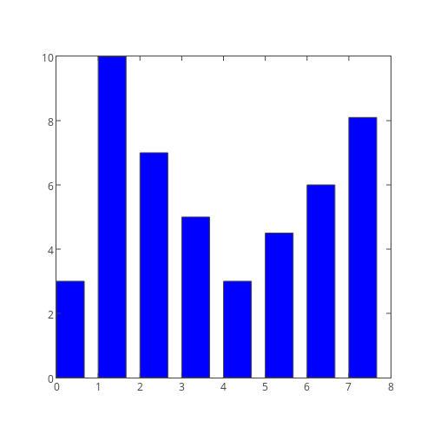
Multi-class classifier
Instead of a single score, the classifier will have a score for each possible label, and then choose the label with the top score.
Learning: different weights for each label.

Slide 33
Linear multi-class classifier
classify(L, F, W): ▷ L: input sentence, F: features to check
S ← [0 for all labels] W: table of weights for features for each
i ← 1 label
while i ≤ len(F): ▷ go through possible features
f ← F[i]
if f(L): ▷ the feature f is true for L
S ← S + W[f] ▷ add the feature’s weight to the score
i ← i + 1 for each label
return argmax(S)

Slide 34
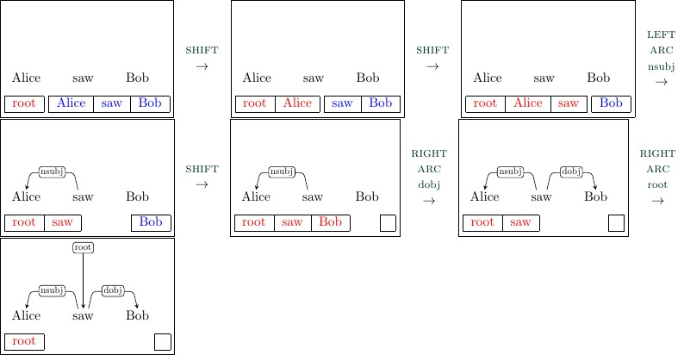
Back to parsing

Slide 35
Perceptron for parsing
If we see the state on the left here, we need to know to apply right-arc_{dobj}

Slide 36
Features for parsing
rightmost token on the stack is <w>?
buffer leftmost part-of-speech is <p>?
second stack token is a parent?
etc.

Slide 37
Perceptron for parsing
Perceptron + word/part-of-speech
unigram, bigram features: pretty good parser.
Parser | UAS (%) | LAS (%)
MaltParser | 90.93 | 88.95
Parsey McParseface | 94.41 | 92.55

Slide 38
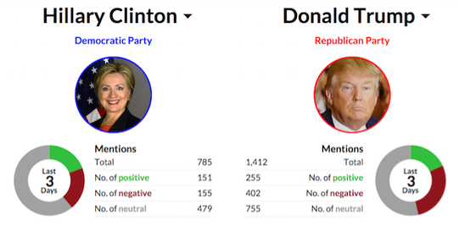
Twitter sentiment analysis
Training any model requires labeled data: learning from examples.

Slide 39
Problem: labeling
Manually annotating tweets takes time and money.

Slide 40
Avoiding manual work
Automatically building a training set using the emoticons in the tweets:
positive |  |  | negative
:) | :D | : ) | :( | =( | : (
:-) | =) | ;) | :-( | :/ | =/
Alec Go, Richa Bhayani, and Lei Huang. 2009. Twitter sentiment classification using distant supervision. Technical report, Stanford.

Slide 41
Problem: sarcasm
People sometimes say the opposite of what they mean.

Slide 42
Sarcasm recognition
Sarcasm: “saying the opposite of what you mean in a way intended to make someone else feel stupid or show you are angry”.
listening to Andrew Ridgley by Black Box Recorder on @Grooveshark: http://tinysong.com/cO6i #goodmusic
I guess you should expect a WONDERFUL video tomorrow. #sarcasm
Accuracy: 94.7%
Oren Tsur, Dmitry Davidov, Ari Rappoport. ICWSM - A Great Catchy Name: Semi-Supervised Recognition of Sarcastic Sentences in Product Reviews. Fourth International AAAI Conference on Weblogs and Social Media (ICWSM) 2010.
Oren Tsur, Dmitry Davidov, Ari Rappoport. Semi-Supervised Recognition of Sarcastic Sentences in Twitter and Amazon. Computational Natural Language Learning (CoNLL) 2010.

Slide 43
Multi-class labels
Hashtag- and smiley-based labels: 51 or 16 labels instead of just two (positive/negative)
Hashtags | Smileys
#sad | ;)
#crazy | :(
#bored | X(
#fun | :S
Dmitry Davidov, Oren Tsur, Ari Rappoport. Enhanced Sentiment Learning Using Twitter Hashtags and Smileys. COLING 2010.

Slide 44
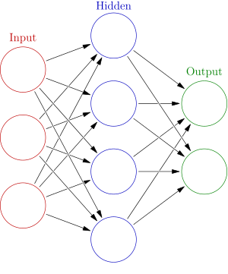
Artificial neural networks
Instead of using the score for classification, give it to another linear classifier (“multi-layer perceptron”)

Slide 45
Artificial neural networks
Only the output of the last layer is actually used for classification.

Slide 46
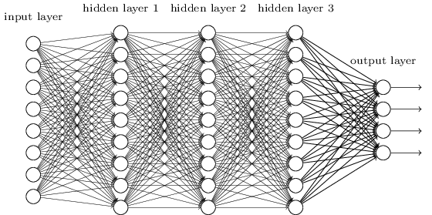
Deep neural networks
Many layers sometimes work better.
(“deep learning”)

Slide 47
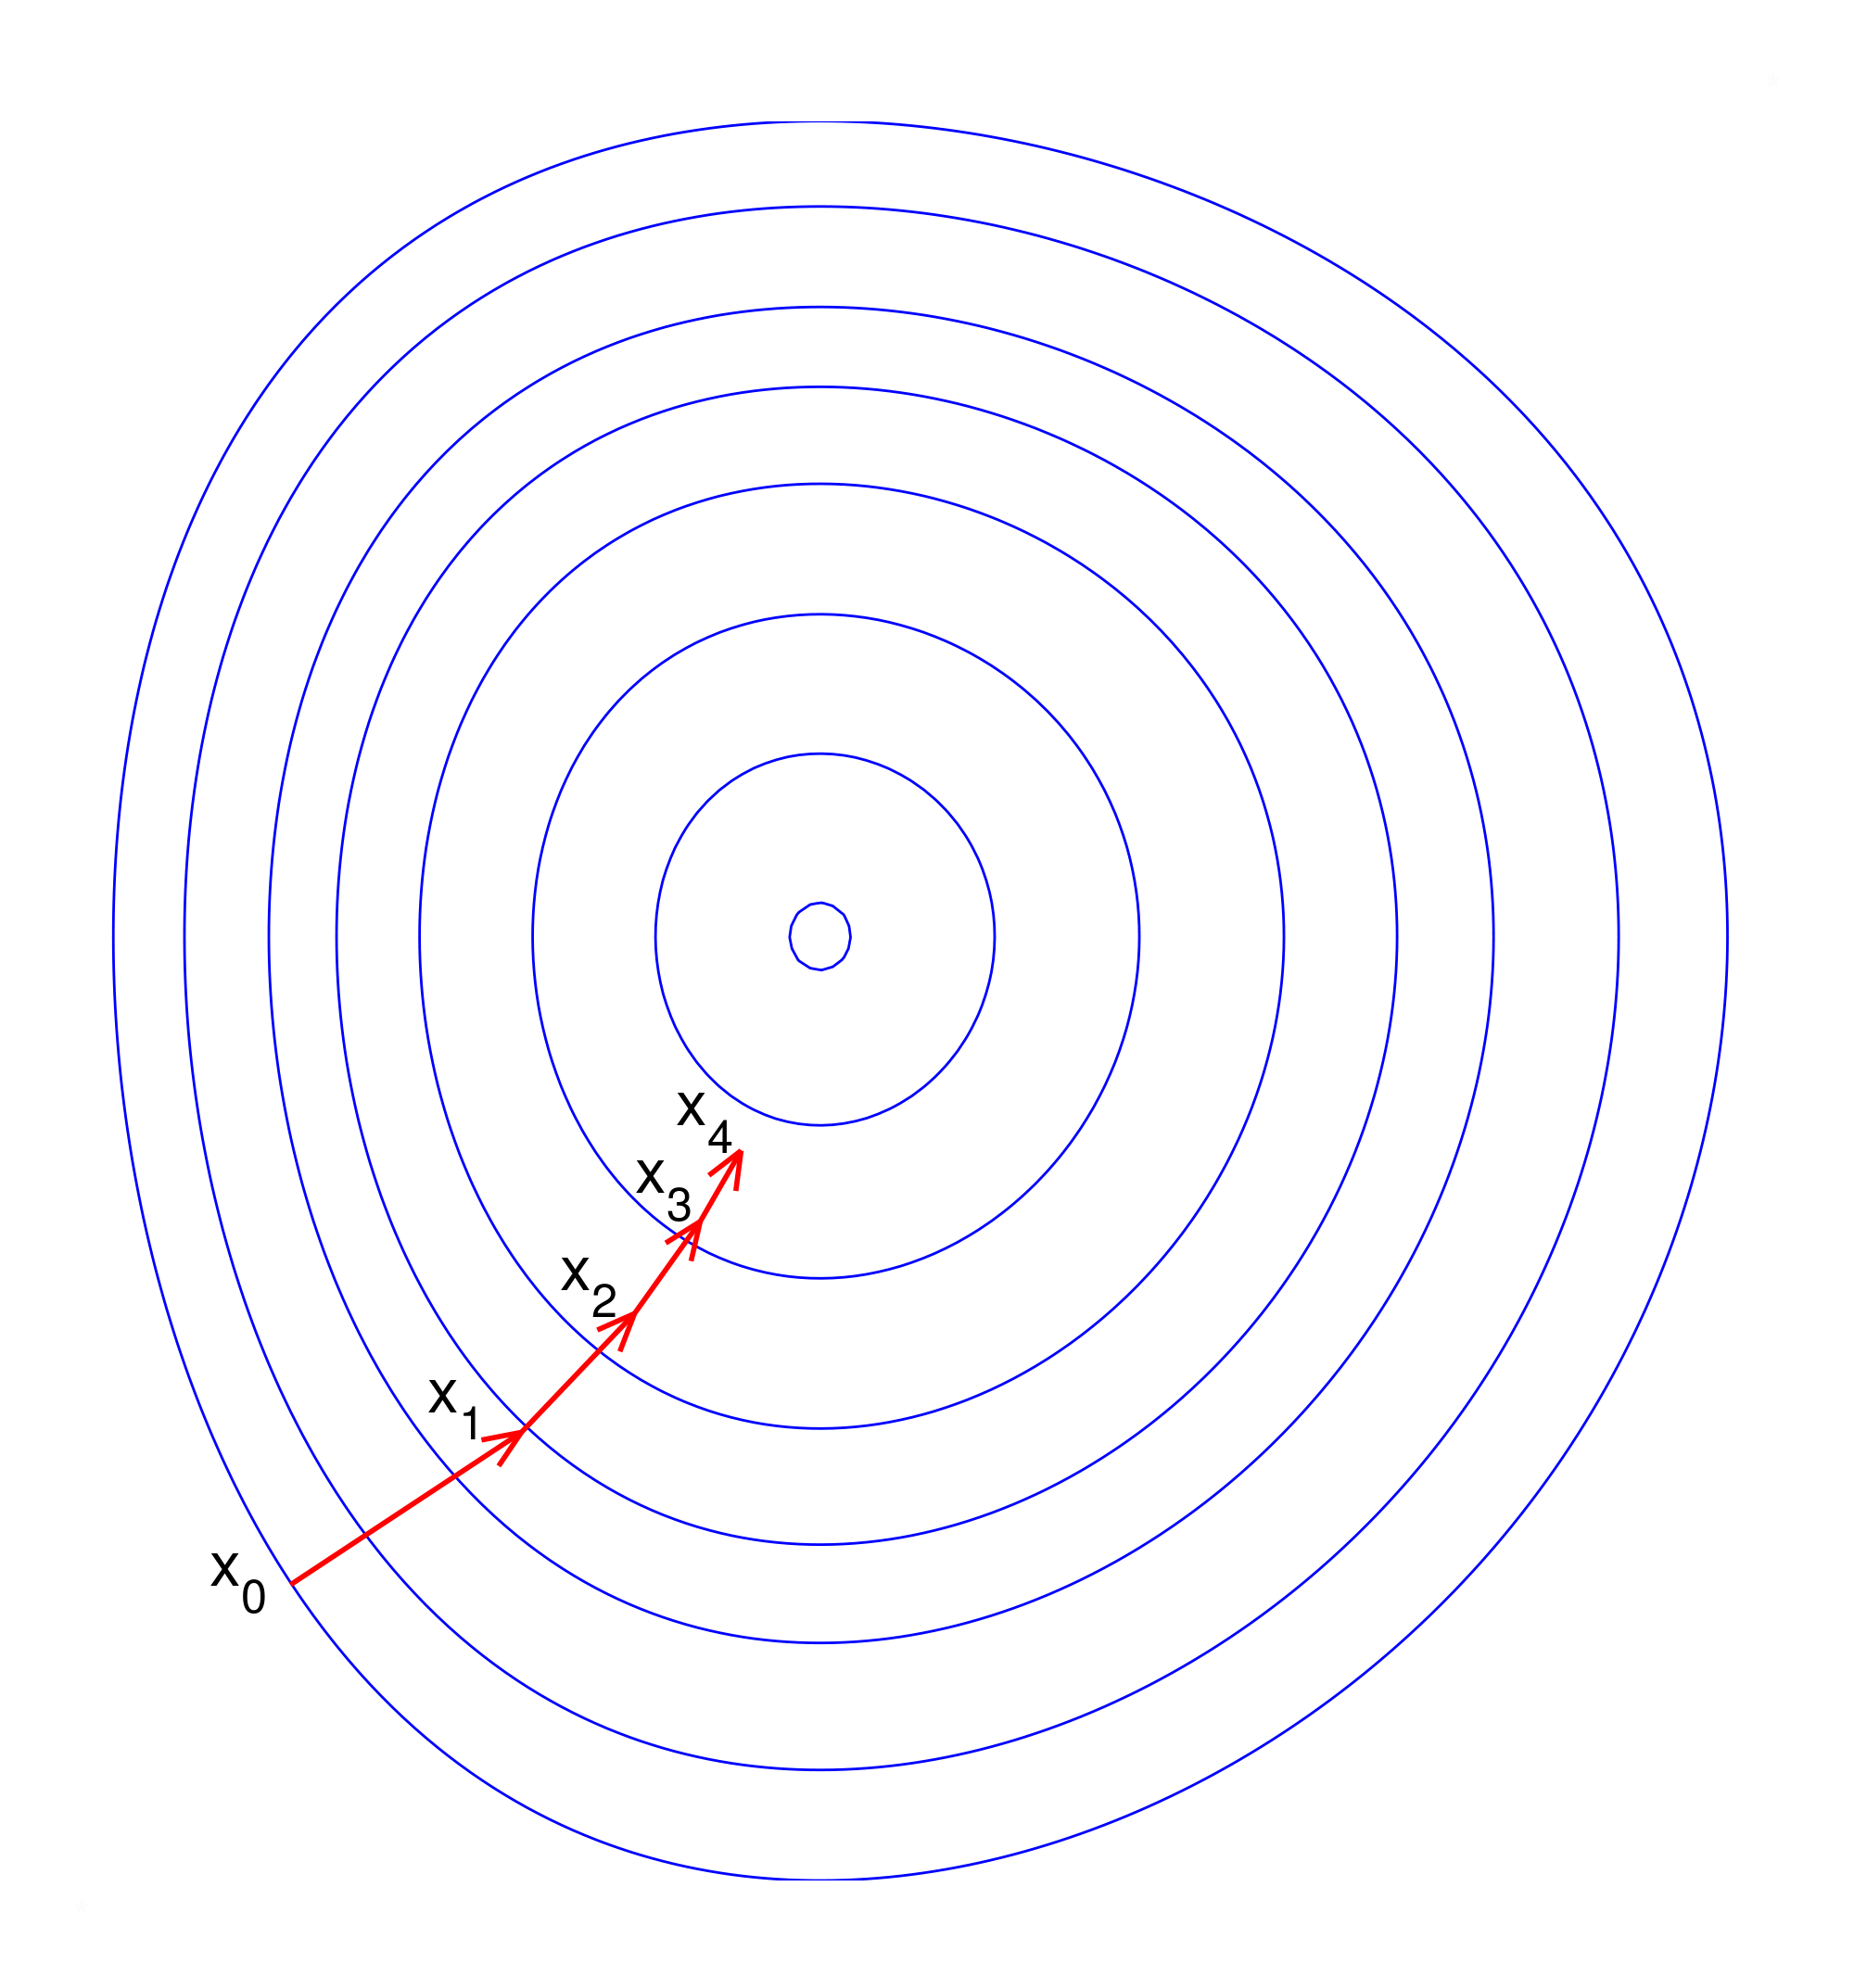
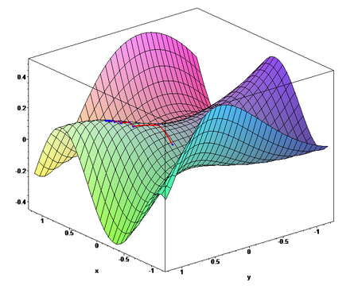
Training neural networks
Perceptron only works for one layer.
Instead, use gradient descent algorithms.

Slide 48
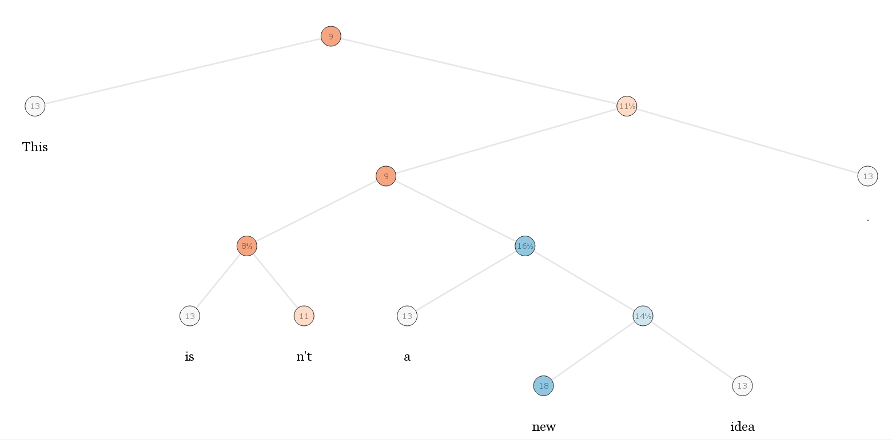
Sentiment treebank
nlp.stanford.edu/sentiment/treebank.html

Slide 49
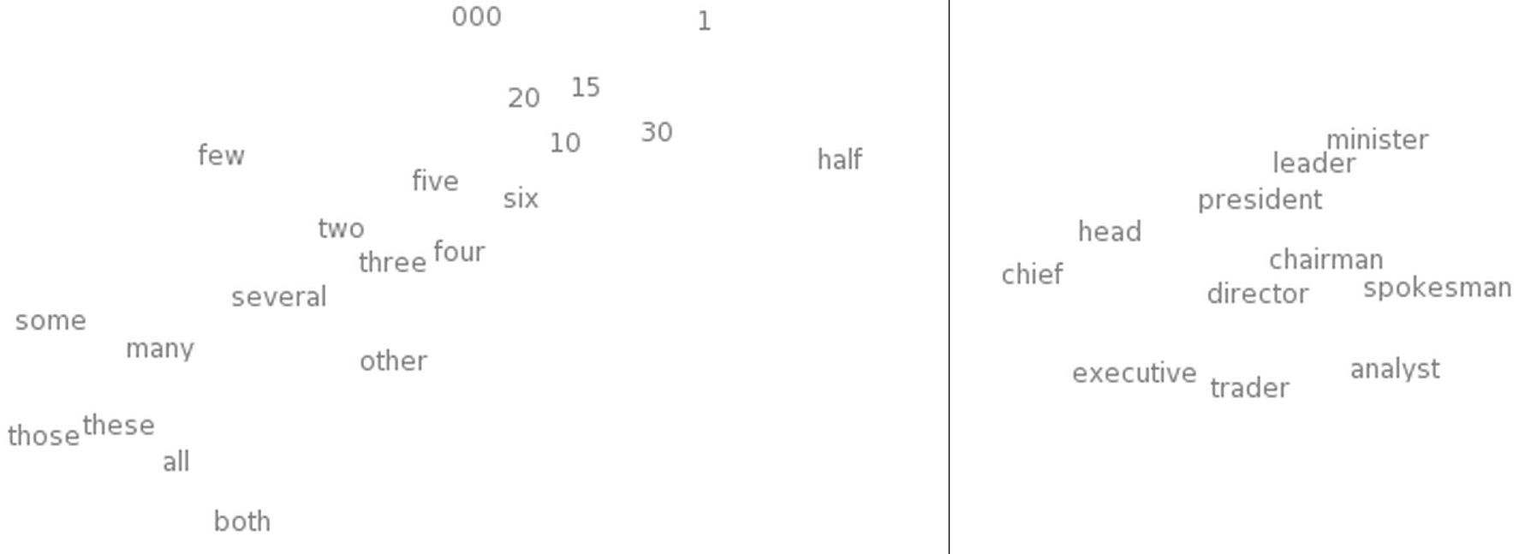
Word embedding
Use vectors to represent words.

Slide 50
NNs for parsing
NN + word embedding features: best parsers today.
Parser | UAS (%) | LAS (%)
MaltParser | 90.93 | 88.95
Parsey McParseface | 94.41 | 92.55

Slide 51
Links
http://www.sciencefriction.net/blog/2010/12/06/1120/
https://www.aclweb.org/anthology/E/E17/E17-2017.pdf
https://research.googleblog.com/2016/05/announcing-syntaxnet-worlds-most.html
http://www.cs.huji.ac.il/~danielh/P17-1104.pdf
https://github.com/ayushoriginal/Sentiment-Analysis-Twitter

